Slide 1
All About Jose House!
The most wonderful child in The world!
Jose House Jr.
3/8/13
1st Hour

Slide 2
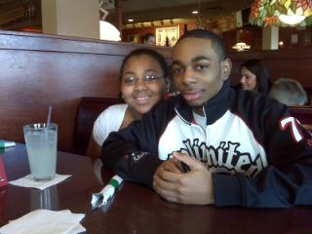
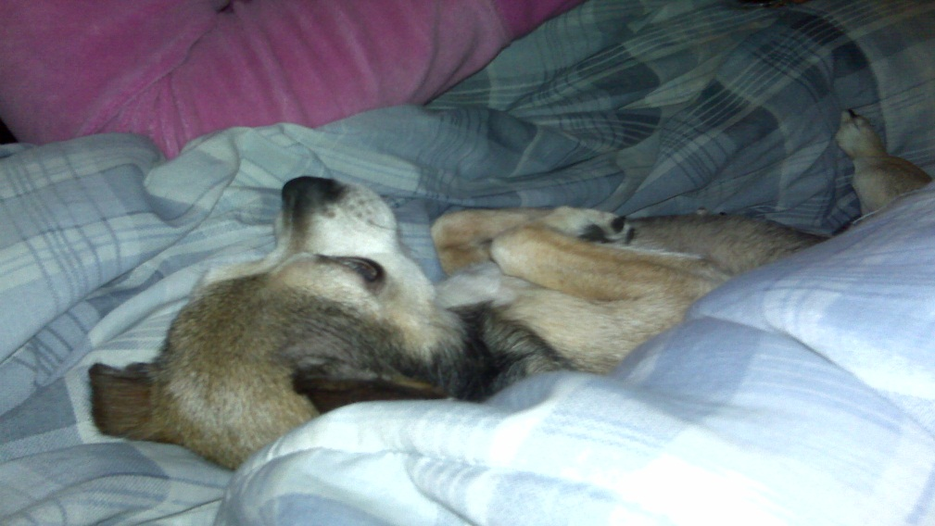
Family Matters!
I have a great family. I have three siblings and of course two parents. My siblings names are Alician-16, Jazmine-17, and Patrick-22. My parents are Jose House Sr. and Patricia House. I also have a dog who died Cinnamon Pebbles House.

Slide 3
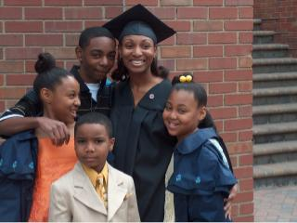
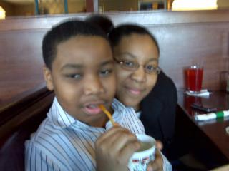
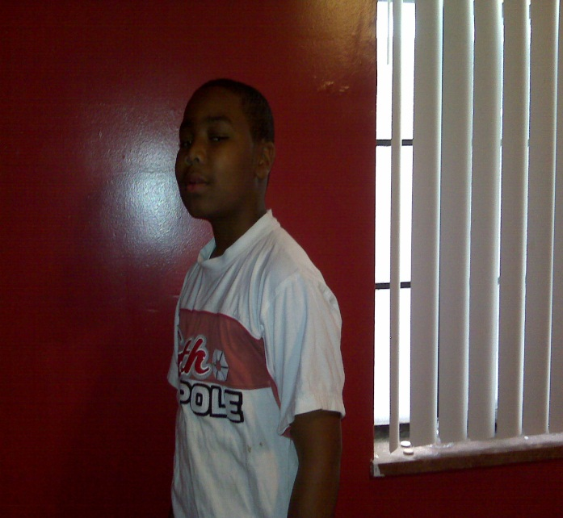
My Childhood
My childhood was great. I went to Rose Elementary. After that I went to DAAS. Then I went to Woodward Academy. During those years I only had three 3.8 grade point averages and the rest were 4.0 averages.

Slide 4
What Happened?
When I was Born…
There was a big blizzard
People died
The world population reaches 6 billion
Pokémon was a big hit so they made an English version for America at the end of 1998
9/11 happened which was a terrorist attack

Slide 5
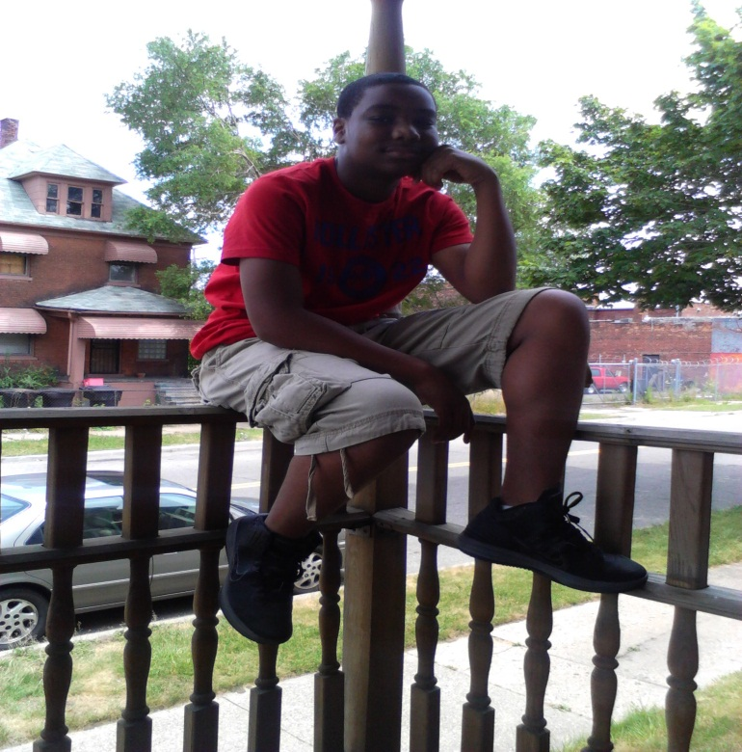
Me Now!
Today I go to Bates Academy and I usually play basketball for fun. I get good grades and I am a Junior Leader in Children's Church. I also do a lot for my church and community like feeding the homeless and giving away old clothes.

Slide 6
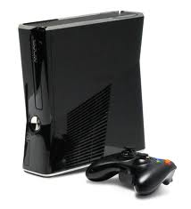
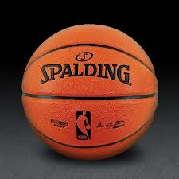
Favorite Things
I love watching movies
I play COD and basketball video games for fun
In the real world I play Basketball and football

Slide 7
Favorite Internet Sites
YouTube
Footlocker
Pandora Internet Radio

Slide 8
My Future Plans
In my future I plan to be a pediatrician. Since I don’t like blood I may stray away from that and become a Lawyer. I know lots of lawyers and they all are pretty wealthy. If none of this works out I plan to be an MLG pro. I would become one of the most athletic gamers there is and put pro gaming on the market.

Slide 9
Something you don’t know about me!
One thing you don’t know about me is that I am a frosted flakes addict. Sometimes I go downstairs at night and eat some and I love having it for any meal.

Slide 10
My Name
My name is Jose and it means “ God will increase”. This is the exact reason no one in my family calls me Little Jose and the fact that I am a 5 foot 7 gaming athletic beast!!!

Slide 11
References
Name, No “Historical Events Happened In 1999.” Exploring The past. Hisdates.com, Unknown.
Web. 12 Mar. 2013. <.www.hisdates.com/years/1999-historical-events.html>

